Slide 1
Process Synchronization
Course Instructor: Nausheen Shoaib

Slide 2
Multiple Processes
Operating Systems is managing multiple processes:
Multiprogramming- The management of multiple processes within a uniprocessor system.
Multiprocessing- The management of multiple processes within a
multiprocessor.
Distributed Processing- The management of multiple processes
executing on multiple, distributed computer systems.e.g clusters
Big Issue is Concurrency
Notes:
The central themes of operating system design are all concerned with the management of processes and threads:
• Multiprogramming:
The management of multiple processes within a uniprocessor system.
• Multiprocessing:
The management of multiple processes within a multiprocessor.
• Distributed processing:
The management of multiple processes executing on multiple, distributed computer systems.
E. G clusters
Concurrency encompasses a host of design issues, including
communication among processes,
sharing of and competing for resources (such as memory, files, and I/O access),
synchronization of the activities of multiple processes, and
allocation of processor time to processes.

Slide 3
Concurrency [1/2]
Concurrency encompasses a host of design issues, including :
communication among processes
sharing of and competing for resources (such as memory, files, and I/O access)
synchronization of the activities of multiple processes
allocation of processor time to processes

Slide 4
Concurrency [2/2]
Concurrency arises in:
Multiple applications
Sharing time
Structured applications
Extension of modular design
Operating system structure
OS themselves implemented as a set of processes or threads
Notes:
• Multiple applications:
Multiprogramming was invented to allow processing time to be dynamically shared among a number of active applications.
• Structured applications:
As an extension of the principles of modular design and structured programming, some applications can be effectively programmed as a set of concurrent processes.
• Operating system structure:
The same structuring advantages apply to systems programs, and we have seen that operating systems are themselves often implemented as a set of processes or threads.

Slide 5
Difficulties of Concurrency
Sharing of global resources
Writing a shared variable: the order of writes is important
Incomplete writes a major problem
Optimally managing the allocation of resources
Difficult to locate programming errors as results are not deterministic and reproducible.
Notes:
The sharing of global resources
If two processes both make use of the same global variable
and both perform reads and writes on that variable,
then the order in which the various reads and writes are executed is critical.
Managing Resources
It is difficult for the OS to manage the allocation of resources optimally.
E.G. A process may request use of, and be granted control of, a particular I/O channel and then be suspended before using that channel.
It may be undesirable for the OS simply to lock the channel and prevent its use by other processes;
indeed this may lead to a deadlock condition,
Locating Programming Errors
It becomes very difficult to locate a programming error because results are typically not deterministic and reproducible

Slide 6
Race Condition
A situation where several processes access and manipulate the same data concurrently and the outcome of the execution depends on the particular order in which the access takes place.

Slide 7
Example for Race condition
Suppose a customer wants to book a seat on UAL 56. Ticket agent will check the #-of-seats. If it is greater than 0, he will grab a seat and decrement #-of-seats by 1.
UAL 56: #-of-seats=12
Main memory
…
Terminal
Terminal
Terminal
Ticket Agent 1
Ticket Agent 2
Ticket Agent n

Slide 8
Example for Race condition(cont.)
Ticket Agent 1
P1: LOAD #-of-seats
P2: DEC 1
P3: STORE #-of-seats
Ticket Agent 2
Q1: LOAD #-of-seats
Q2: DEC 1
Q3: STORE #-of-seats
Ticket Agent 3
R1: LOAD #-of-seats
R2: DEC 1
R3: STORE #-of-seats
Suppose instructions are interleaved as P1,Q1,R1,P2,Q2,R2,P3,Q3,R3
To solve the above problem, we must make sure that:
P1,P2,P3 must be completely executed before we execute Q1 or R1, or
Q1,Q2,Q3 must be completely executed before we execute P1 or R1, or
R1,R2,R3 must be completely executed before we execute P1 or Q1.

Slide 9
The Critical Section / Region Problem
Occurs in systems where multiple processes all compete for the use of shared data.
Each process includes a section of code (the critical section) where it accesses this shared data.
The problem is to ensure that only one process at a time is allowed to be operating in its critical section.

Slide 10
Critical Regions (1)
Conditions required to avoid race condition:
No two processes may be simultaneously inside their critical regions.
No assumptions may be made about speeds or the number of CPUs.
No process running outside its critical region may block other processes.
No process should have to wait forever to enter its critical region.
Tanenbaum, Modern Operating Systems 3 e, (c) 2008 Prentice-Hall, Inc. All rights reserved. 0-13-6006639

Slide 11
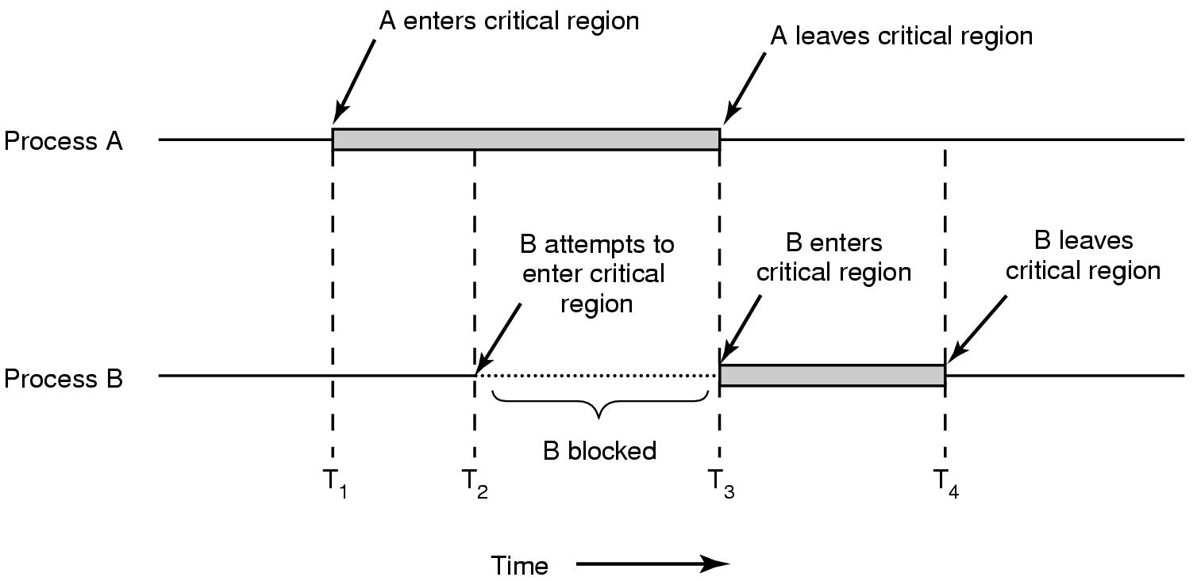
Critical Regions (2)
Mutual exclusion using critical regions.

Slide 12
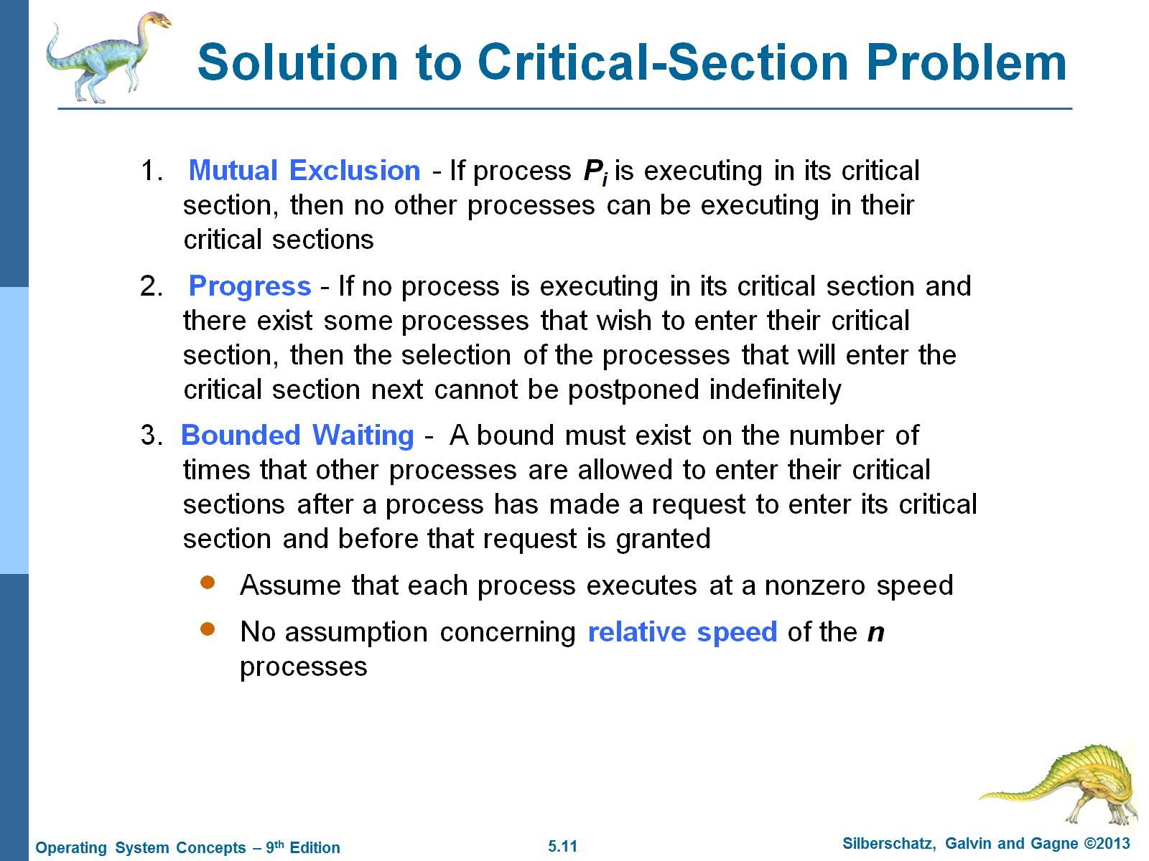
Solution to Critical-Section Problem

Slide 13
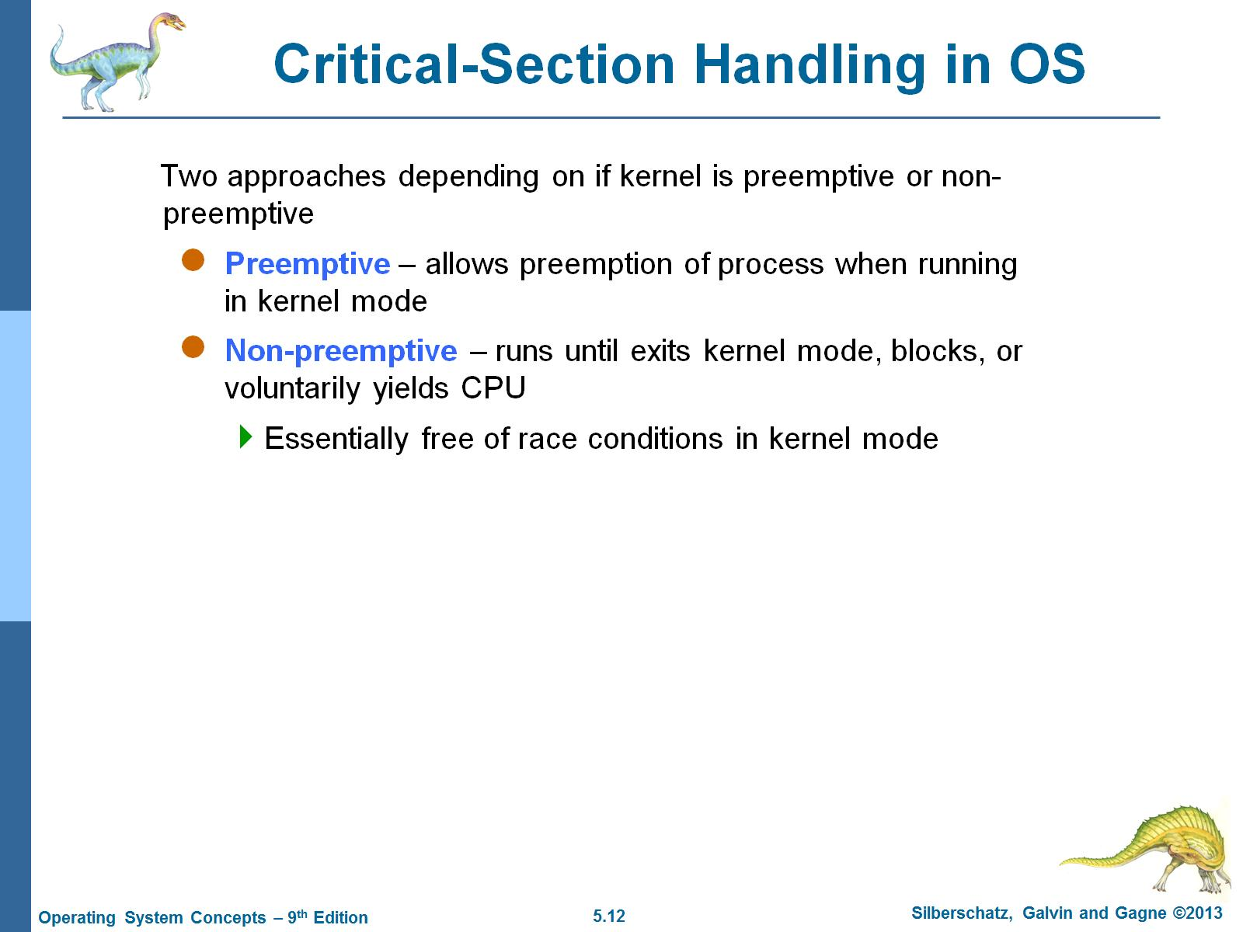
Critical-Section Handling in OS

Slide 14
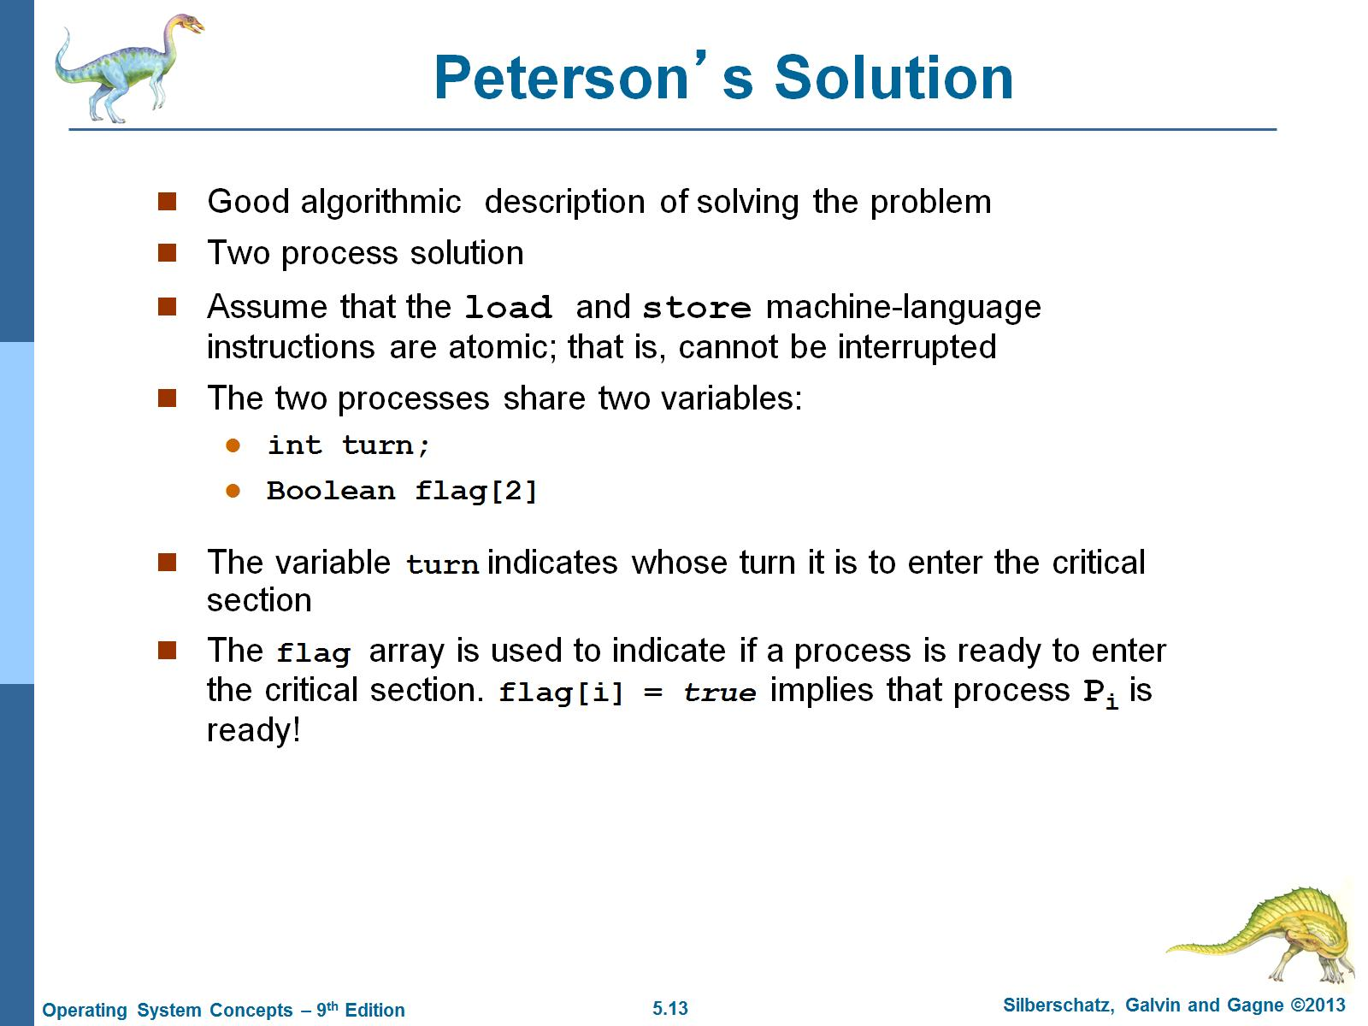
Peterson’s Solution

Slide 15
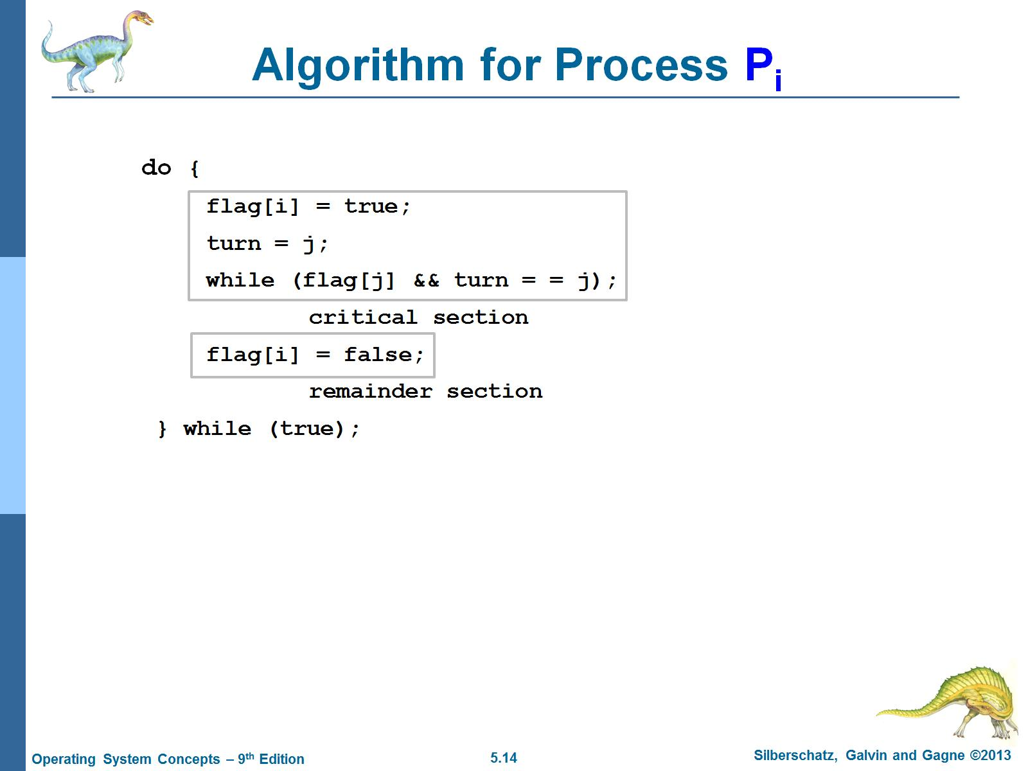
Algorithm for Process P_{i}

Slide 16
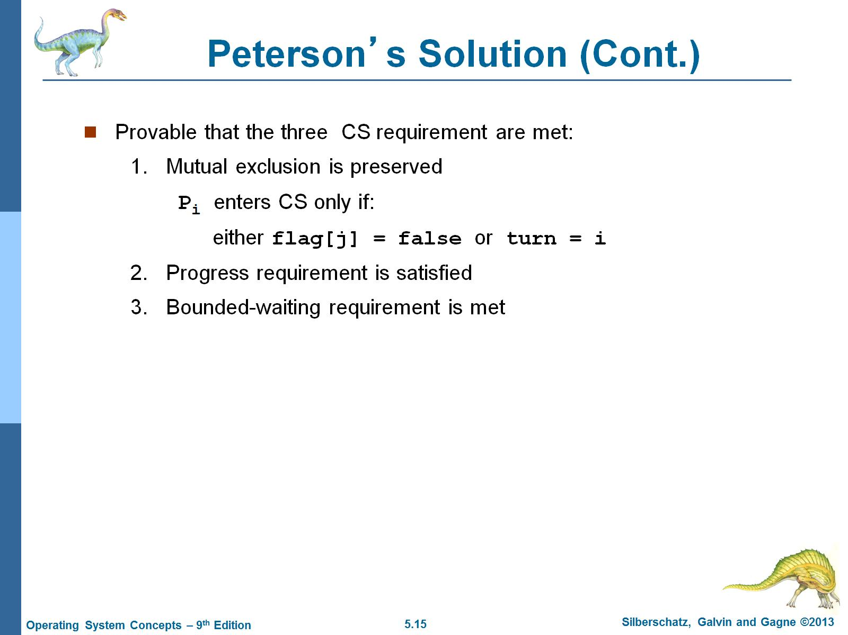
Peterson’s Solution (Cont.)

Slide 17
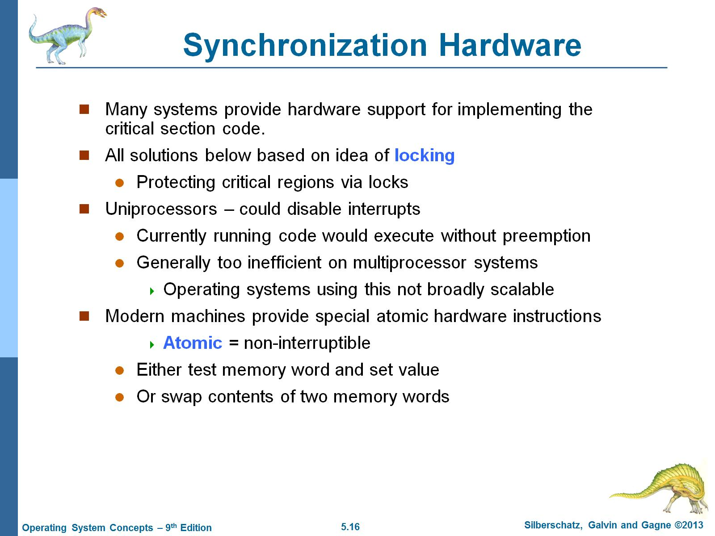
Synchronization Hardware

Slide 18
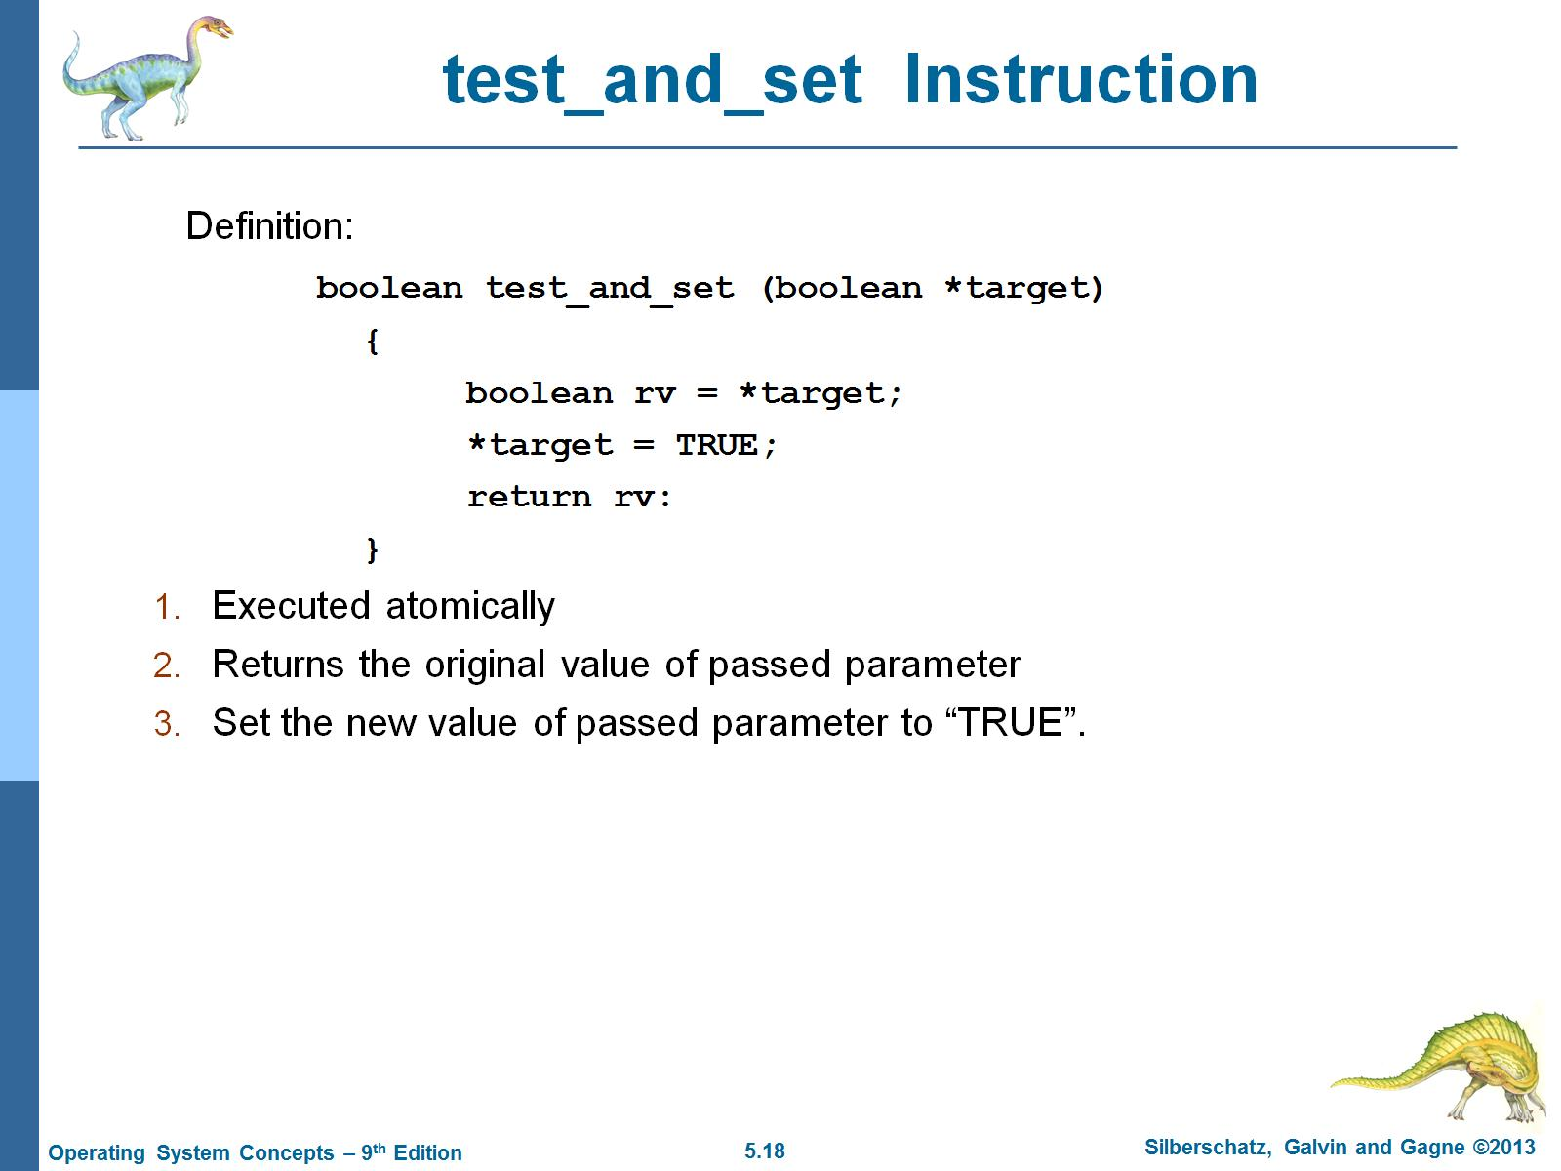
test_and_set Instruction

Slide 19
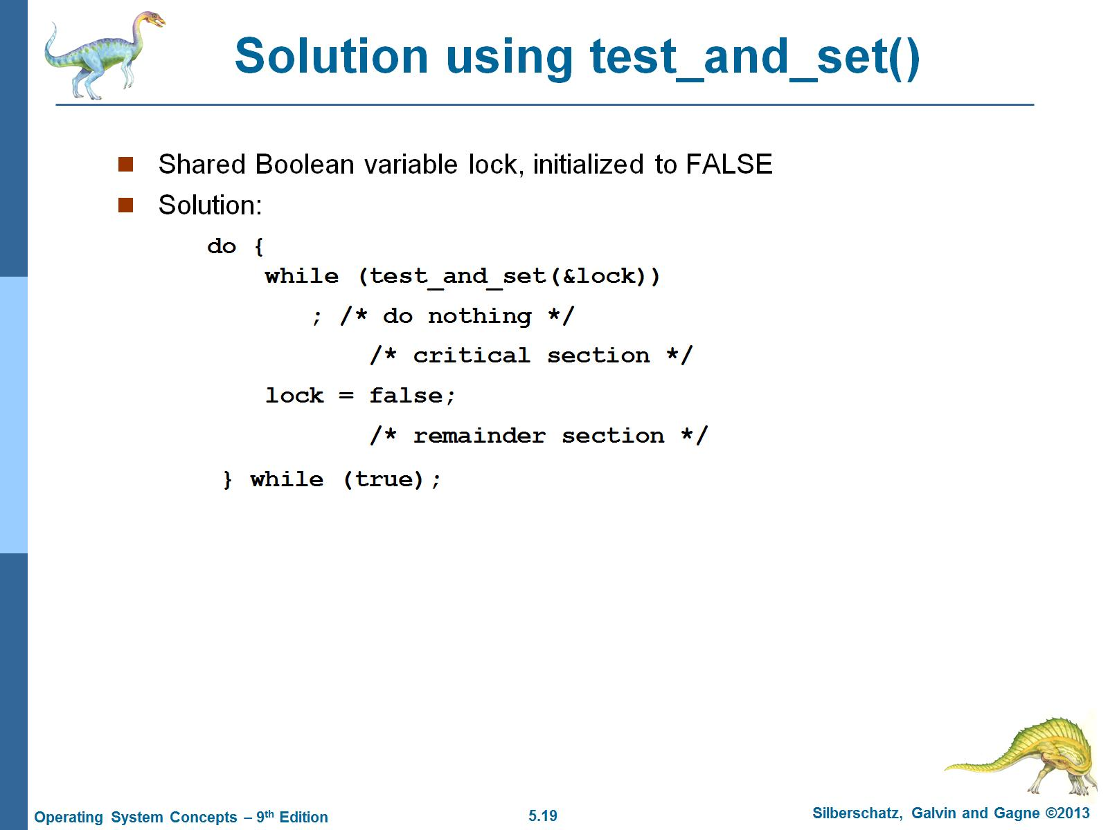
Solution using test_and_set()

Slide 20
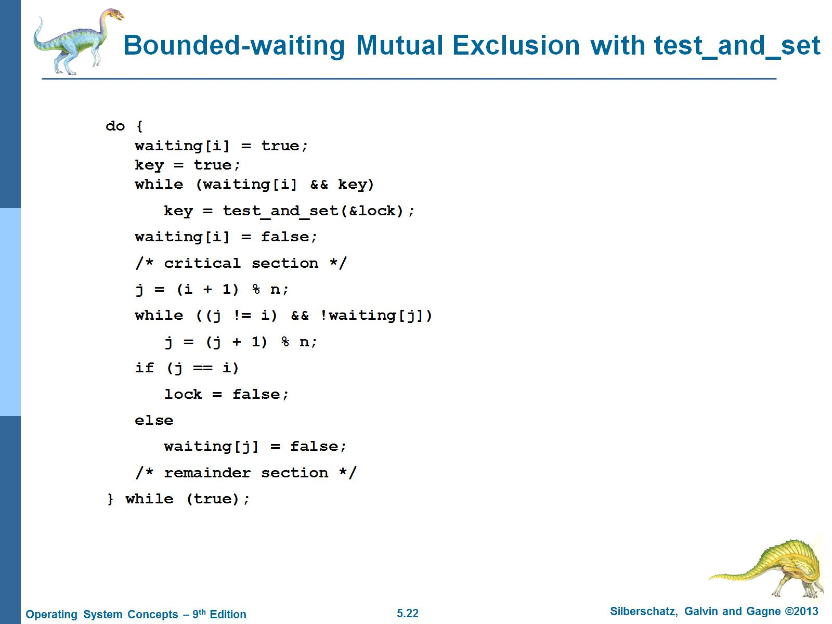
Bounded-waiting Mutual Exclusion with test_and_set

Slide 21
Mutex Locks
OS designers build software tools to solve critical section problem
Simplest is mutex lock
Product critical regions with it by first acquire() a lock then release() it
Boolean variable indicating if lock is available or not
Calls to acquire() and release() must be atomic
Usually implemented via hardware atomic instructions
But this solution requires busy waiting
Busy Waiting means busy-looping or spinning is a technique in which a process repeatedly checks to see if a condition is true, such as whether keyboard input or a lock is available
Mutex lock therefore called a spinlock

Slide 22
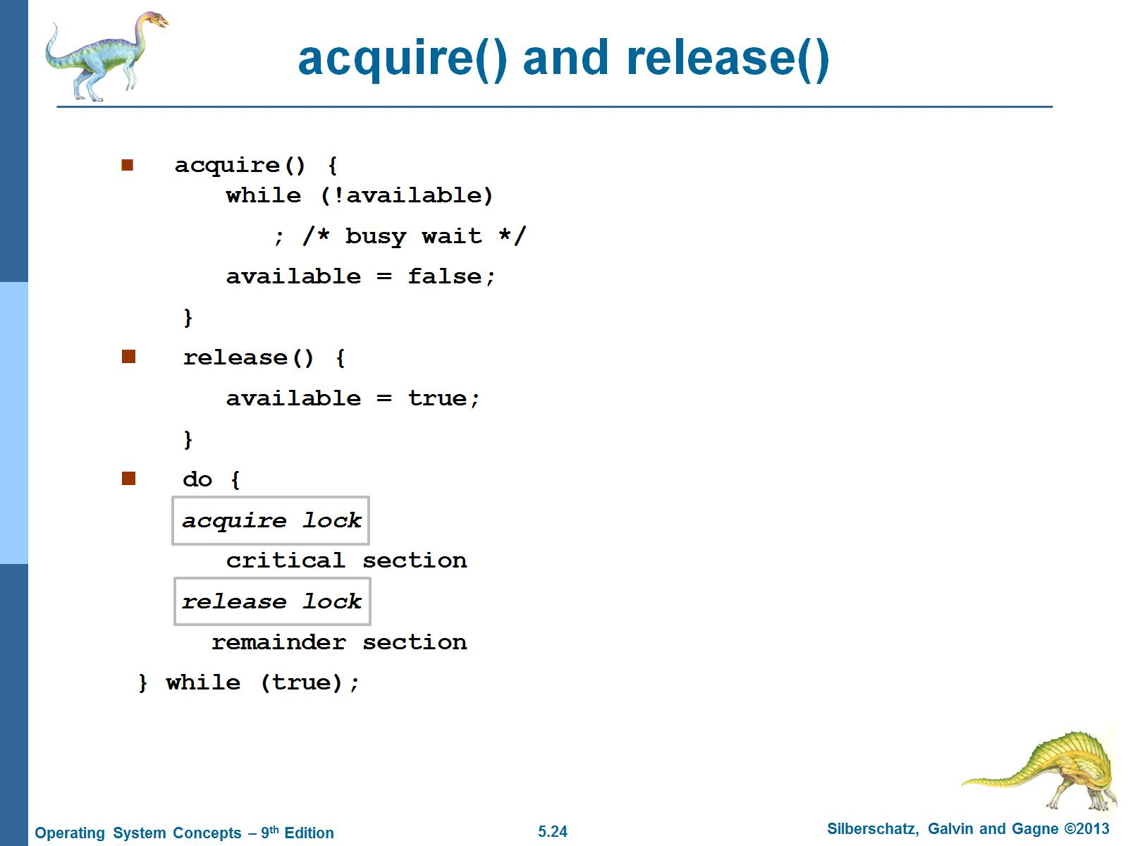
acquire() and release()

Slide 23
Pthreads Synchronization – Mutex Lock
#include <pthread.h>
Pthread_mutex_t mutex;
/* create the mutex lock */
Pthread_mutex_ init(&mutex,NULL);
1st Arg: Mutex initiliazer
2nd Arg: Attributes, NULL means no error checks will be performed

Slide 24
Pthreads Synchronization – Mutex Lock
The mutex is acquired and released with the pthread_mutex_lock()
and pthread_mutex_unlock() functions.
If the mutex lock is unavailable when pthread_ mutex_lock() is invoked, the calling thread is blocked until the owner invokes pthread_mutex_ unlock().

Slide 25
What is a Semaphore
a semaphore is a variable or abstract data type used to control access to a common resource by multiple processes in a concurrent system such as a multiprogramming operating system.

Slide 26
Semaphore
Synchronization tool that does not require busy waiting
Semaphore S – integer variable
Two standard operations modify S: wait() and signal()
Less complicated
Can only be accessed via two indivisible (atomic) operations
Definition of wait() operation:
wait (S) {
while (S <= 0)
; // busy wait
S--;
}
Definition of signal() operation:
signal (S) {
S++;
}
when one process modifies the semaphore value, no other process can simultaneously modify that same semaphore value.

Slide 27
Semaphore Usage
Counting Semaphore:
Semaphores which allow an arbitrary resource count are called counting semaphores,
Counting semaphores can be used to control access to a given resource
consisting of a finite number of instances
Can implement a counting semaphore S as a binary semaphore
Binary Semaphore:
while semaphores which are restricted to the values 0 and 1 (or locked/unlocked, unavailable/available) are called binary semaphores and are used to implement locks.
Binary semaphores behave similarly to mutex locks.
Can implement a counting semaphore S as a binary semaphore

Slide 28
Semaphore Usage
consider two concurrently running processes: P1 with a statement S1 and P2 with a statement S2.
It is required that S2 be executed only after S1 has completed. We can implement this scheme readily by letting P1and P2 share a common semaphore synch, initialized to 0.
P1:
S₁;
signal(synch);
P2:
wait(synch);
S₂;
Because synch is initialized to 0, P2 will execute S2 only after P1 has invoked signal(synch), which is after statement S1 has been executed.

Slide 29
Semaphore Implementation
Must guarantee that no two processes can execute wait() and signal() on the same semaphore at the same time
Thus, implementation becomes the critical section problem where the wait and signal code are placed in the critical section
Could now have busy waiting in critical section implementation
Note that applications may spend lots of time in critical sections and therefore this is not a good solution

Slide 30
Semaphore Implementation with no Busy waiting
With each semaphore there is an associated waiting queue
Two operations:
block – place the process invoking the operation on the appropriate waiting queue
wakeup – remove one of processes in the waiting queue and place it in the ready queue

Slide 31
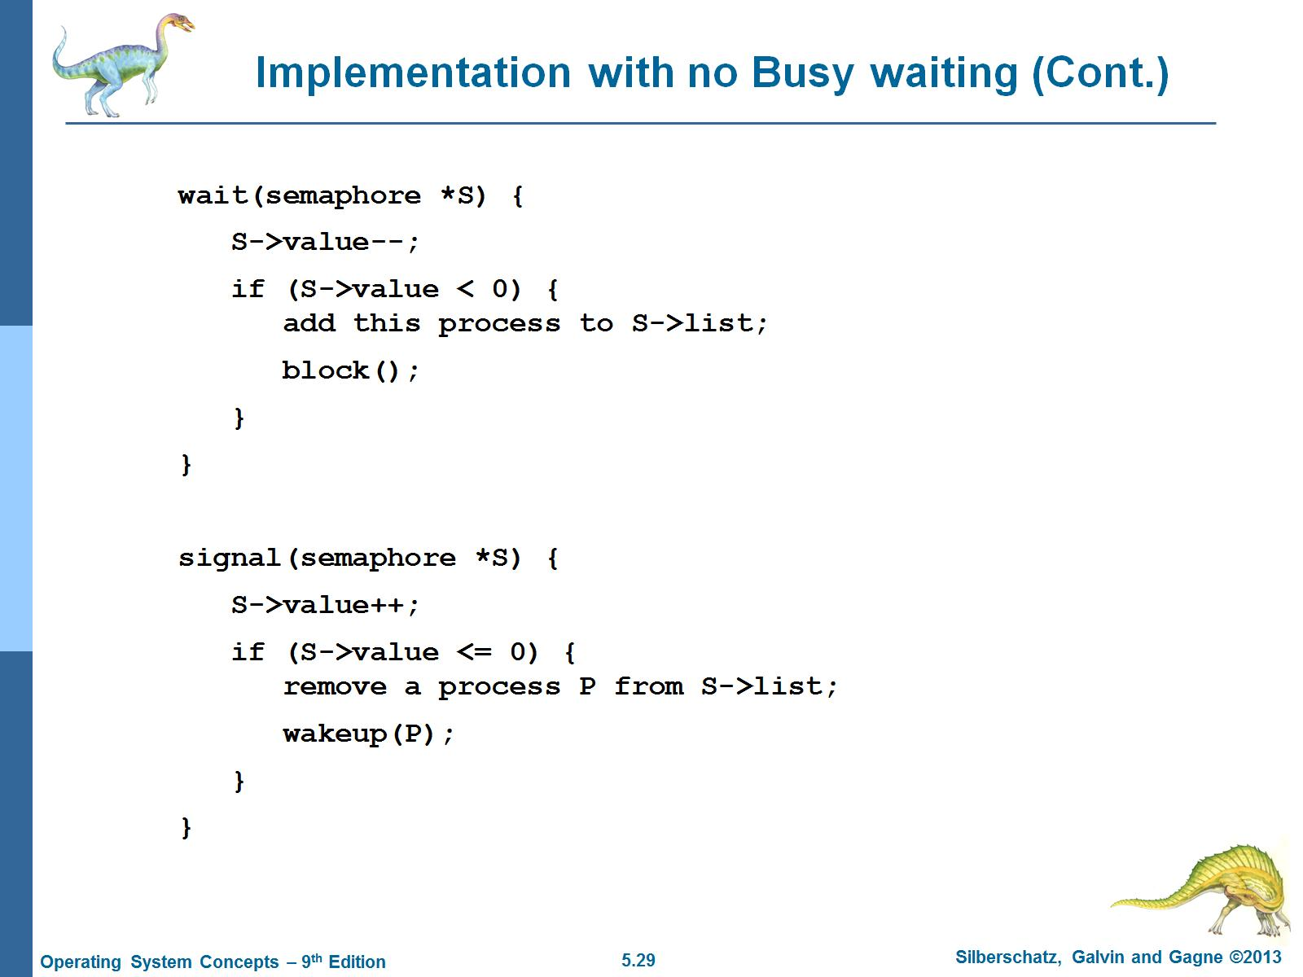
Implementation with no Busy waiting (Cont.)

Slide 32
POSIX - Semaphores
#include <semaphore.h>
Sem_t sem;
/* Create the semaphore and initialize it to 1 */
Sem_init(&sem, 0, 1);
The sem_init() function is passed three parameters:
1. A pointer to the semaphore
2. A flag indicating the level of sharing
3. The semaphore’s initial value

Slide 33
POSIX - Semaphores
/* acquire the semaphore */
Sem_wait(&sem);
/* critical section */
/* release the semaphore */
Sem_post(&sem);

Slide 34
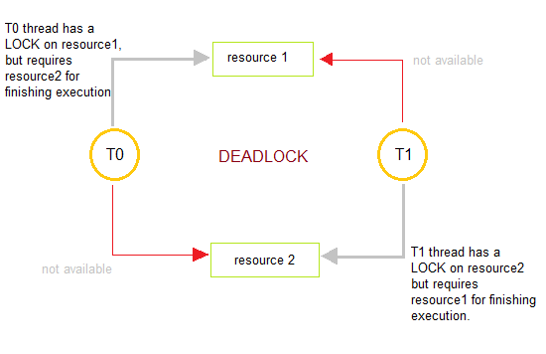
Deadlock
Deadlocks are a set of blocked processes each holding a resource and waiting to acquire a resource held by another process

Slide 35
Starvation
Starvation is the name given to the indefinite postponement of a process because it requires some resource before it can run, but the resource, though available for allocation, is never allocated to this process.

Slide 36
Deadlock Vs. Starvation
Deadlock refers to the situation when processes are stuck in circular waiting for the resources.
On the other hand, starvation occurs when a process waits for a resource indefinitely.

Slide 37
Priority Inversion
Priority Inversion – Scheduling problem when lower-priority process holds a lock needed by higher-priority process
Solved via priority-inheritance protocol

Slide 38
Priority Inheritance Protocol
when a job blocks one or more high-priority jobs, it ignores its original priority assignment and executes its critical section at an elevated priority level.
After executing its critical section and releasing its locks, the process returns to its original priority level

Slide 39
Classical Problems of Synchronization
Classical problems used to test newly-proposed synchronization schemes
Bounded Buffer Problem
Dining-Philosophers Problem
Readers and Writers Problem

Slide 40
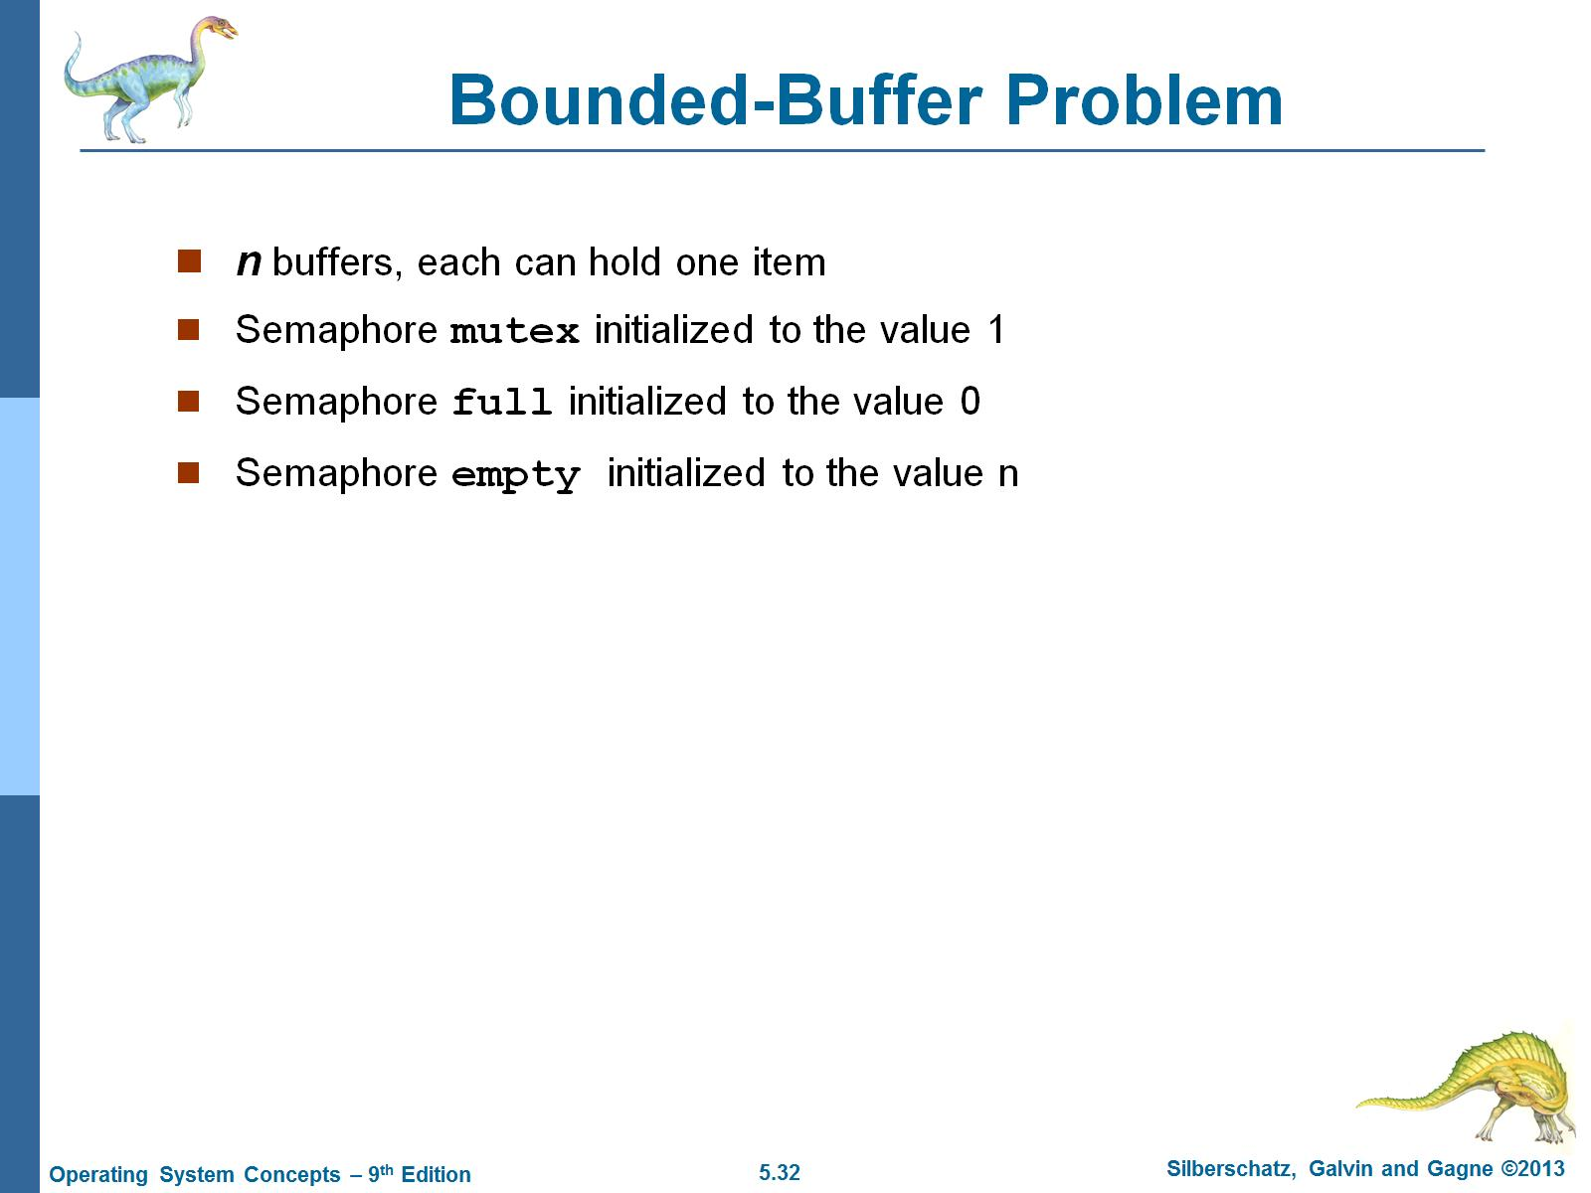
Bounded-Buffer Problem

Slide 41
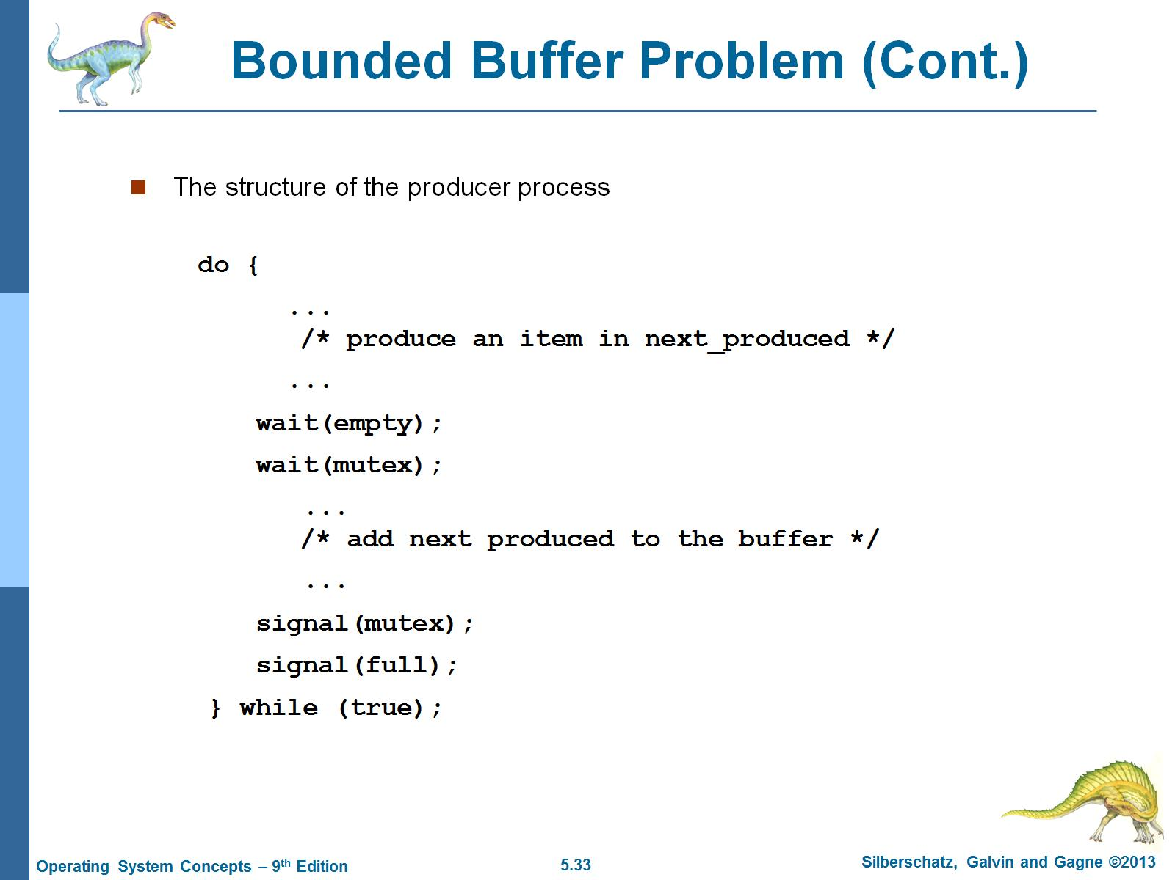
Bounded Buffer Problem (Cont.)

Slide 42
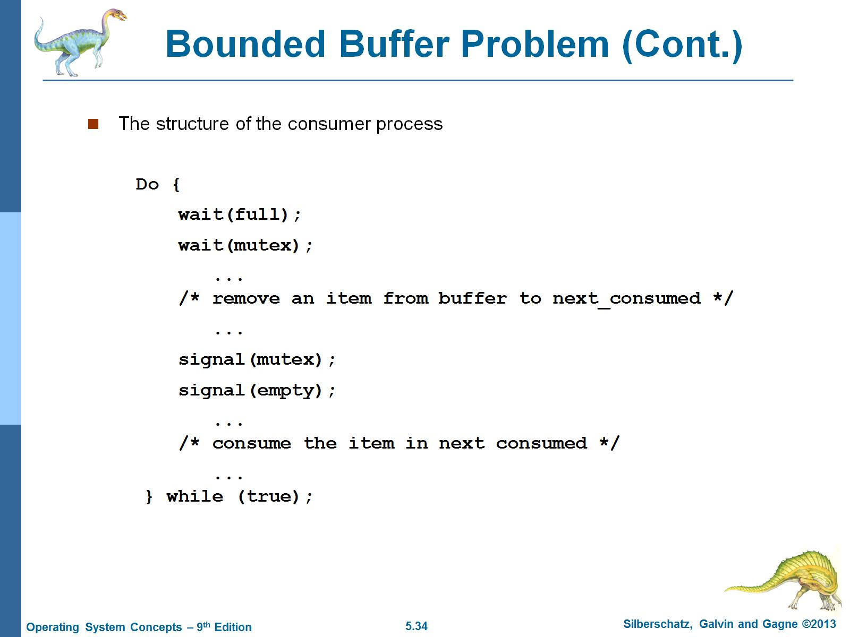
Bounded Buffer Problem (Cont.)

Slide 43
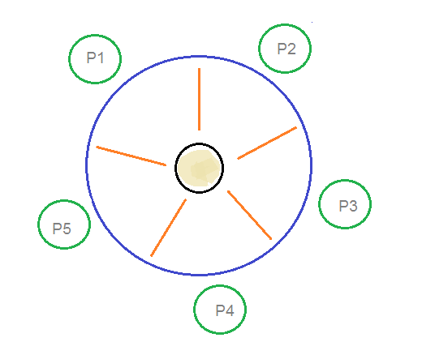
Dining-Philosophers Problem
Consider there are five philosophers sitting around a circular dining table. The dining table has five chopsticks and a bowl of rice.

Slide 44
Dining-Philosophers Solution
it is clear that a philosopher can think for an indefinite amount of time. But when a philosopher starts eating, he has to stop at some point of time

Slide 45
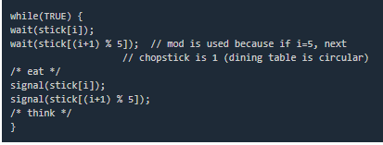
Dining-Philosophers Solution 1
An array of five semaphores, stick[5], for each of the five chopsticks.
The code for each philosopher looks like:

Slide 46
Dining-Philosophers Solution 1
When a philosopher wants to eat the rice, he will wait for the chopstick at his left and picks up that chopstick.
Then he waits for the right chopstick to be available, and then picks it too. After eating, he puts both the chopsticks down

Slide 47
Dining-Philosophers Problem
But if all five philosophers are hungry simultaneously, and each of them pickup one chopstick, then a deadlock situation occurs:
Deadlock implies starvation but starvation does not imply deadlock

Slide 48
Dining-Philosophers Solution 2
Two Possible solutions are :
A philosopher must be allowed to pick up the chopsticks only if both the left and right chopsticks are available.
Allow only four philosophers to sit at the table. That way, if all the four philosophers pick up four chopsticks, there will be one chopstick left on the table. So, one philosopher can start eating and eventually, two chopsticks will be available. In this way, deadlocks can be avoided.

Slide 49
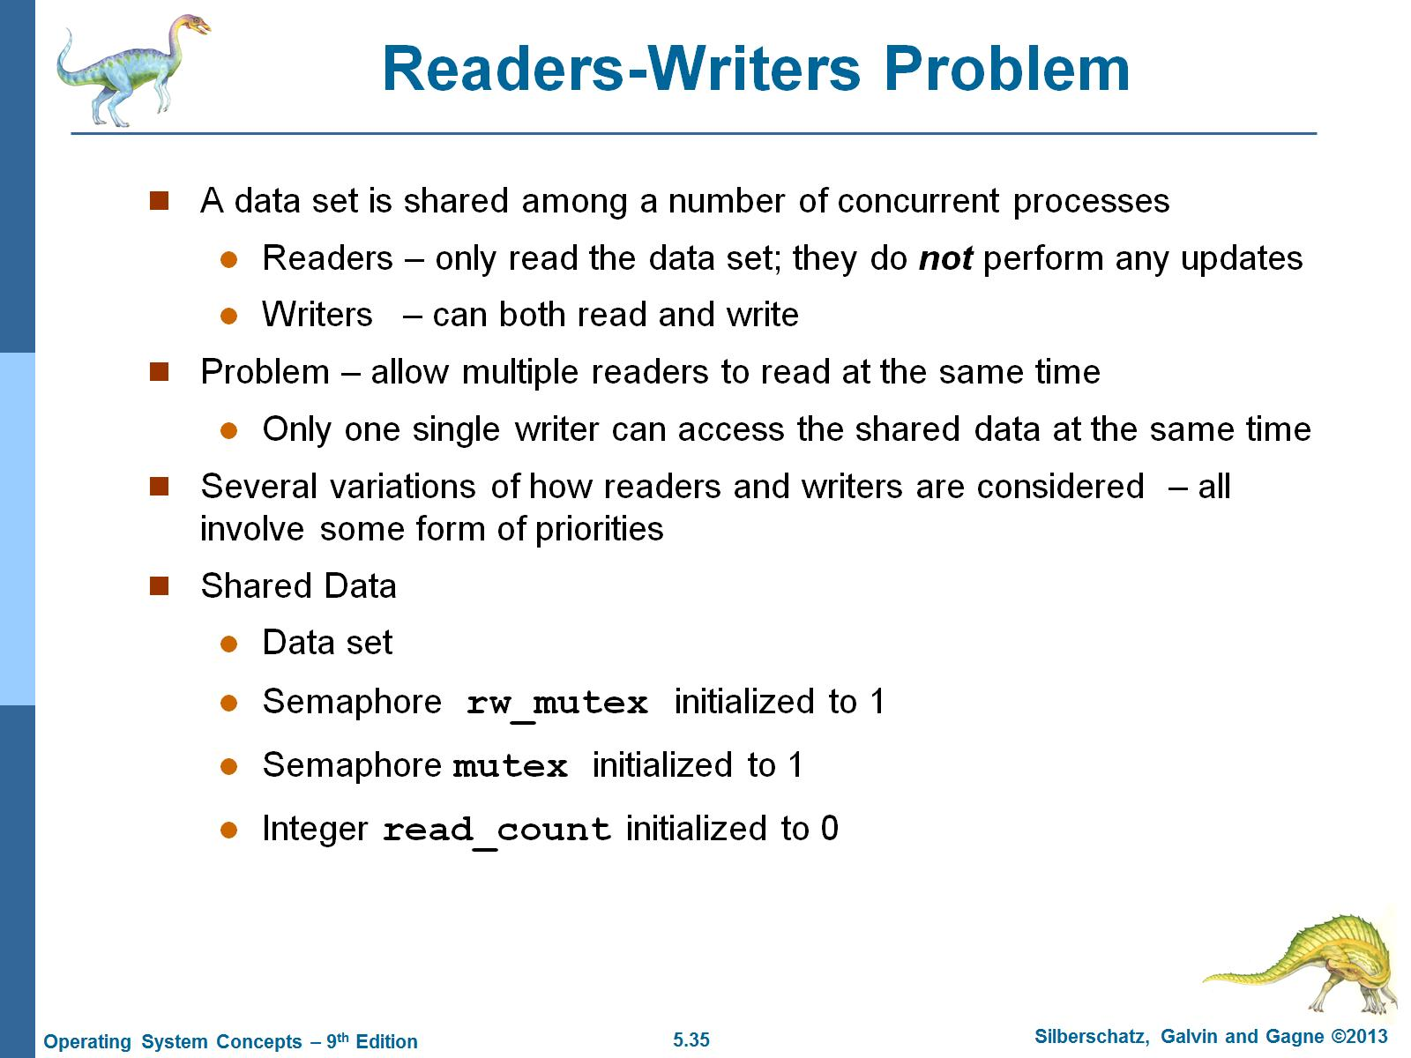
Readers-Writers Problem

Slide 50
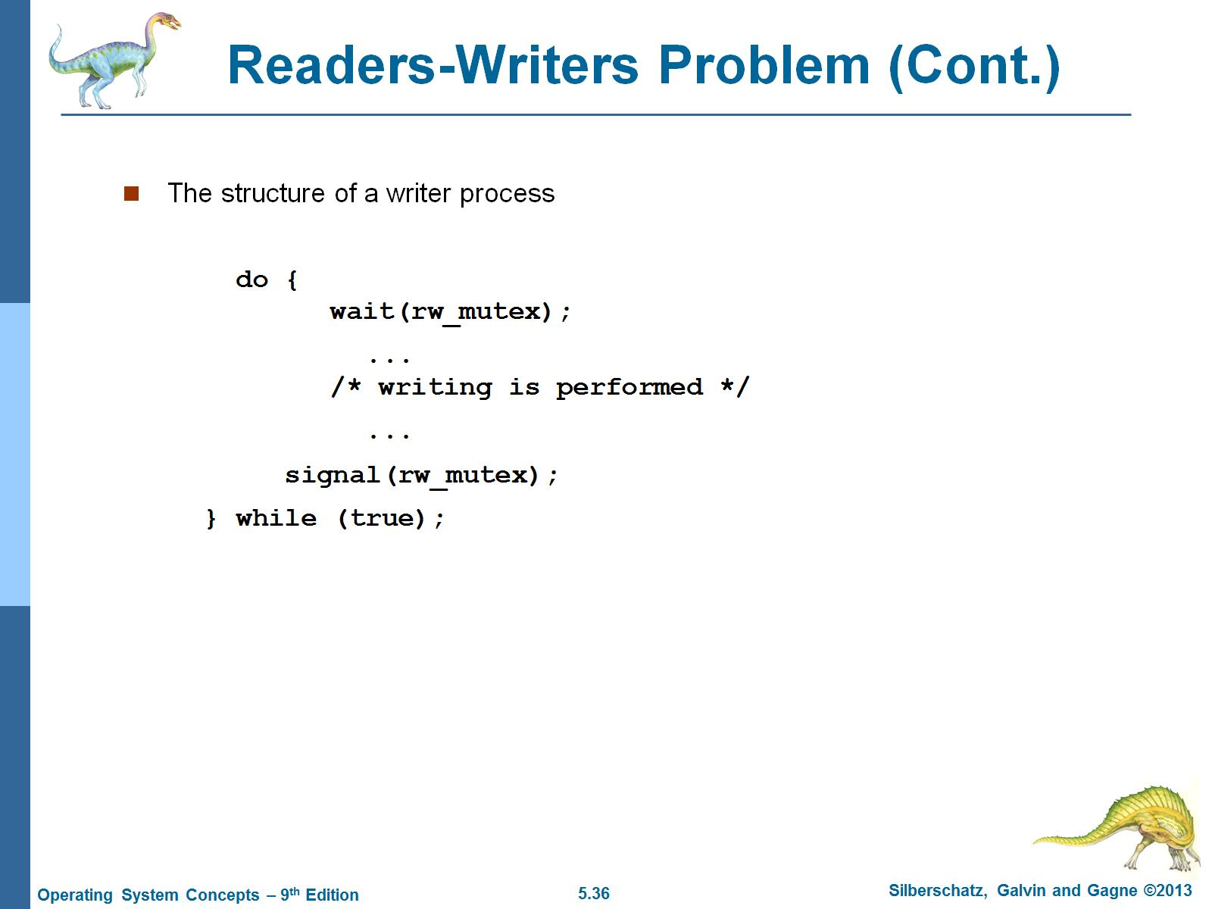
Readers-Writers Problem (Cont.)

Slide 51
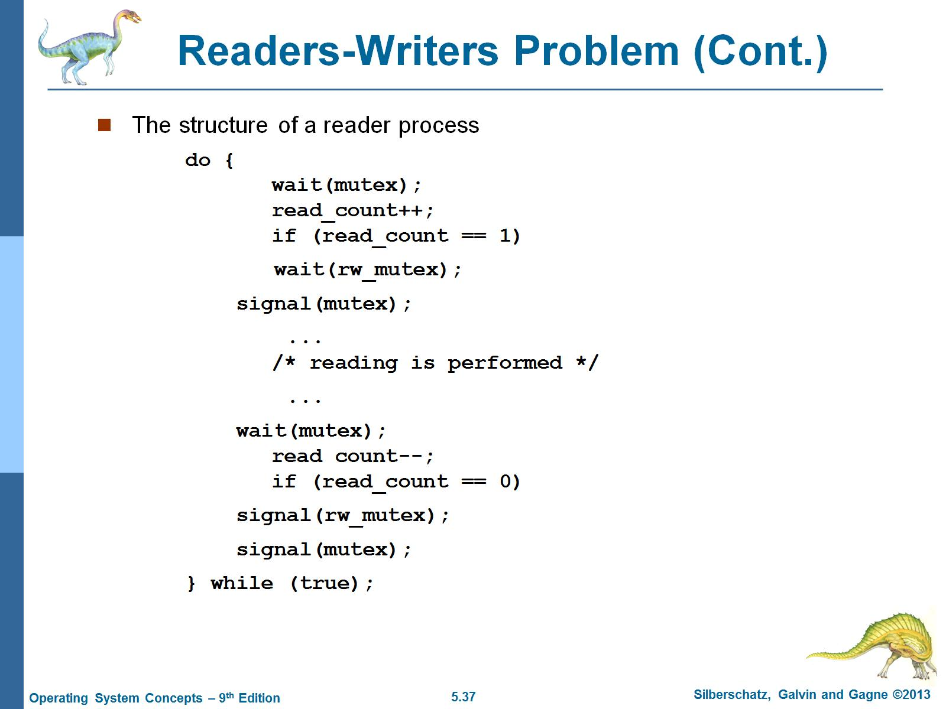
Readers-Writers Problem (Cont.)

Slide 52
Monitors [1/2]
a monitor is a synchronization construct that allows threads to have both mutual exclusion and the ability to wait (block) for a certain condition to become true.
Monitors also have a mechanism for signaling other threads that their condition has been met
A monitor consists of a mutex (lock) object and condition variables.

Slide 53
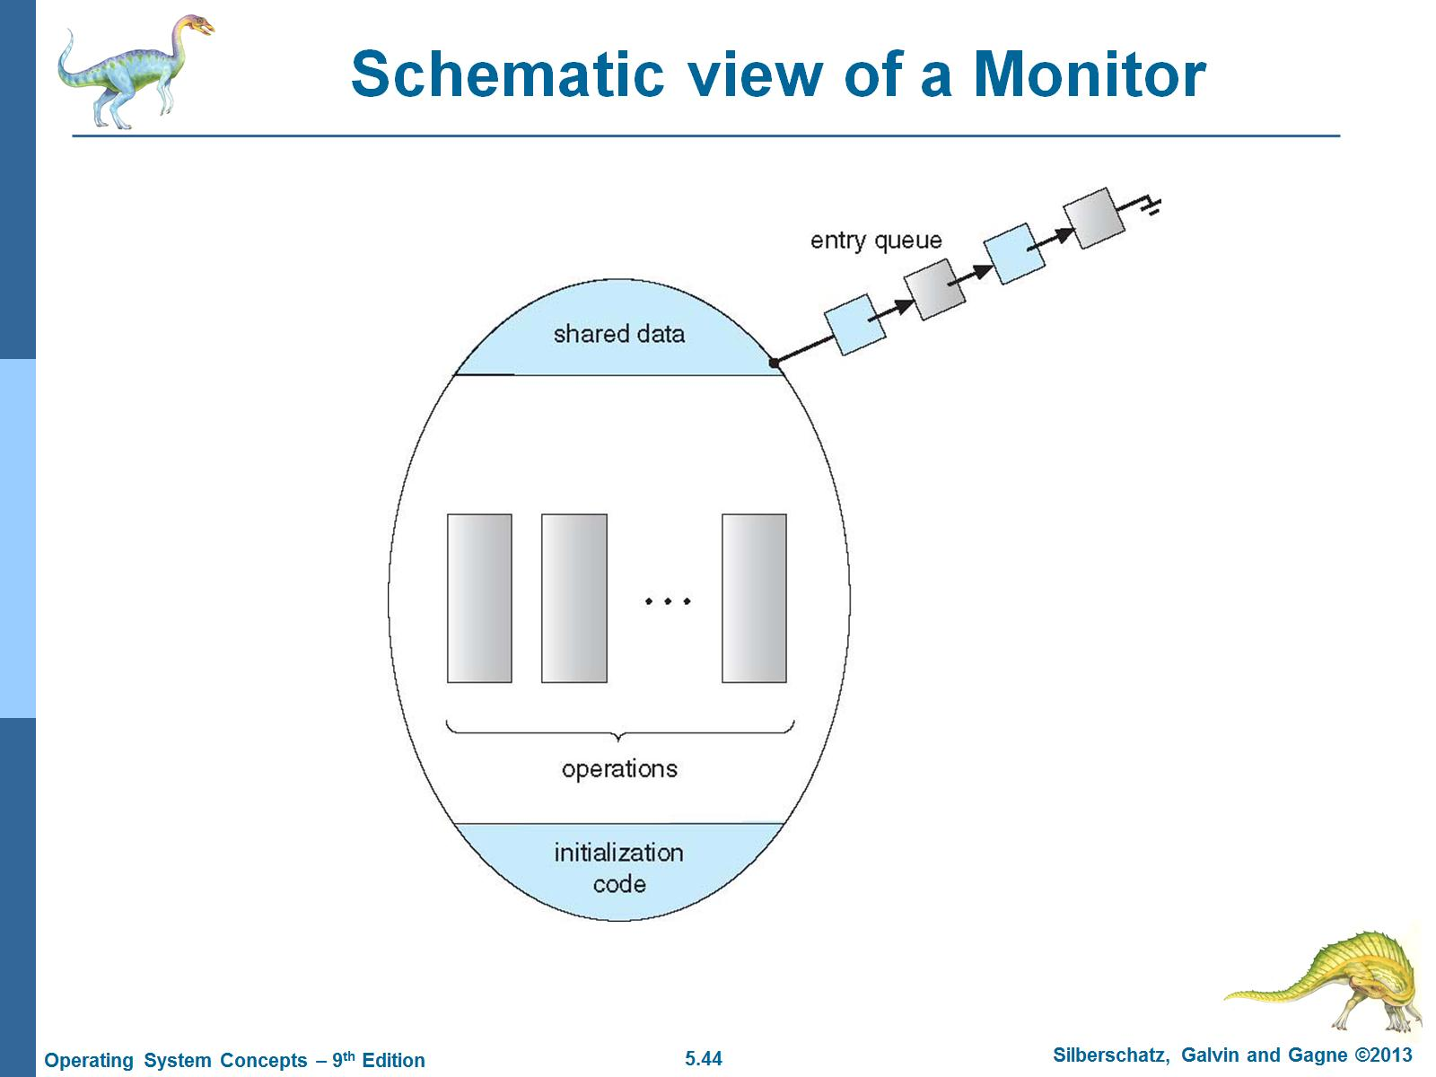
Schematic view of a Monitor

Slide 54
Monitors & Condition Variables [2/2]
A condition variable is basically a container of threads that are waiting for a certain condition.
Monitors provide a mechanism for threads to temporarily give up exclusive access in order to wait for some condition to be met, before regaining exclusive access and resuming their task.

